Slide 1

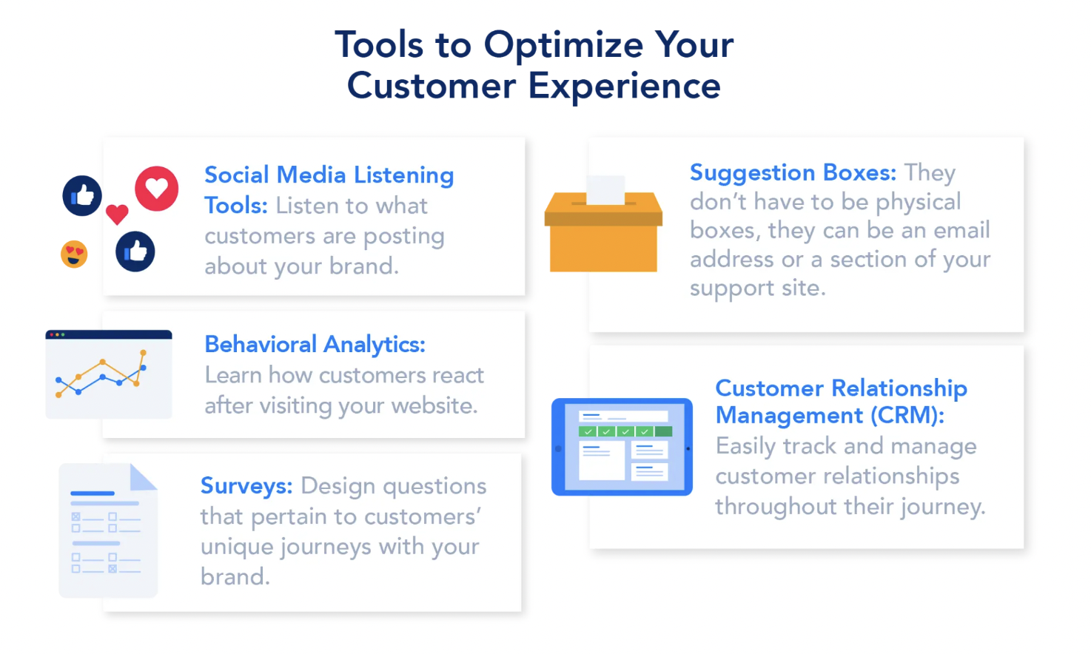
ABC Call Volume Trend Analysis Sumeet Dutta

Slide 2

Content
Project description
assumption
Project approach
Tech-stack used
Objectives
Insights or approach
results

Slide 3
Project description
This project focuses on analyzing and enhancing the customer experience (CX) for a company's inbound calling team. Inbound customer support is a key touchpoint for businesses, where existing and prospective customers reach out with inquiries, requests, and issues. The goal is to provide valuable insights into call patterns, call handling efficiency, and areas for improvement to increase customer satisfaction and engagement.
With a dataset covering 23 days, this project provides details on call metrics such as agent name and ID, queue time (how long a customer waits before connecting with an agent), call time, call duration, and call status (abandoned, answered, or transferred). These metrics are essential for understanding the effectiveness of the CX team and identifying ways to optimize agent allocation, reduce customer wait times, and minimize call abandonment rates.

Slide 4
assumption
An agent working days per week | 6
Agent Work Hours per Day: | 9 hours
Breaks per Day: | 1.5 hours
Days per Month: | 26 (taking 4 unplanned leaves into account)
Percentage of Time on Calls: | 60%
actual call time per day(hours/seconds): | 4.5 | 16200
total call time per month(seconds per month): | 421200
Data provided for calculation of calls during night time.

Slide 5
Project approach
Understanding and Cleaning the data
Reaching a complete understanding of the data, assessing its impact on the target variable, and effectively addressing data irregularities are crucial steps for improved analysis.
Analysis and Visualization
Conducting data analysis to extract insights and key findings, followed by visualizing the results to enhance clarity and accessibility.

Slide 6
Tech-stack used
Tech-stack used for this project is Microsoft Excel for analyzing and visualizing the dataset and Microsoft PowerPoint to present the dataset.

Slide 7
objectives
Task 1:- What is the average duration of calls for each time bucket?
Task 2:- Can you create a chart or graph that shows the number of calls received in each time bucket?
Task 3:-What is the minimum number of agents required in each time bucket to reduce the abandon rate to 10%?
Task 4:- Propose a manpower plan for each time bucket throughout the day, keeping the maximum abandon rate at 10%.

Slide 8
Task 1 Average Call Duration
Task:- Determine the average duration of all incoming calls received by agents. This should be calculated for each time bucket.
The highest average call duration occurs between 6 PM and 9 PM, while the lowest is observed between 12 PM and 3 PM.

Slide 9
Task 2 Call Volume Analysis
Task:- Visualize the total number of calls received. This should be represented as a graph or chart showing the number of calls against time. Time should be represented in buckets (e.g., 1-2, 2-3, etc.).
Insights:- The highest total number of calls is received between 11 AM and 12 PM, after which the total call volume steadily decreases.

Slide 10
Task 3 Manpower Planning
Task:- The current rate of abandoned calls is approximately 30%. Propose a plan for manpower allocation during each time bucket (from 9 am to 9 pm) to reduce the abandon rate to 10%. In other words, you need to calculate the minimum number of agents required in each time bucket to ensure that at least 90 out of 100 calls are answered.
Insights:- An additional 12 agents are needed to achieve a 10% abandonment rate.

Slide 11
Task 4 Night Shift Manpower Planning
Task:- Customers also call ABC Insurance Company at night but don't get an answer because there are no agents available. This creates a poor customer experience. Assume that for every 100 calls that customers make between 9 am and 9 pm, they also make 30 calls at night between 9 pm and 9 am.
Insights:- A team of 17 night agents is required to handle customer calls during nighttime hours.
Time Buckets | Assumed Call Count | Total Call Count | Agent Required
09pm-10pm | 3 | 154 | 2
10pm-11pm | 3 | 154 | 2
11pm-12am | 2 | 103 | 1
12am-01am | 2 | 103 | 1
01am-02am | 1 | 51 | 1
02am-03am | 1 | 51 | 1
03am-04am | 1 | 51 | 1
04am-05am | 1 | 51 | 1
05am-06am | 3 | 154 | 2
06am-07am | 4 | 205 | 2
07am-08am | 4 | 205 | 2
08am-09am | 5 | 256 | 3
Total | 30 | 1539 | 17

Slide 12
results
The busiest time for agents is from 11 AM to 12 PM.
The company needs an additional 12 agents to achieve the required 90% answer rate.
The company needs 17 night agents to achieve a 90% answer rate for customer queries received at night.

Slide 13

THANK YOU
For the Excel sheet please follow given link:-
Excel Sheet

